Slide 1

PACTight: Tightly Seal Sensitive Pointers with Pointer Authentication
Mohannad Ismail
Master’s Defense

Slide 2

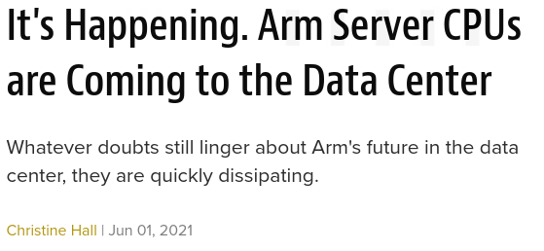


ARM is becoming popular
In recent years, the ARM processor architecture started penetrating into the data center market and mainstream desktop markets (Apple M1) beyond the mobile/embedded segments.
This opens a new realm in terms of security attacks against ARM, increasing the importance of having an effective and efficient defense mechanism for ARM.

Slide 3
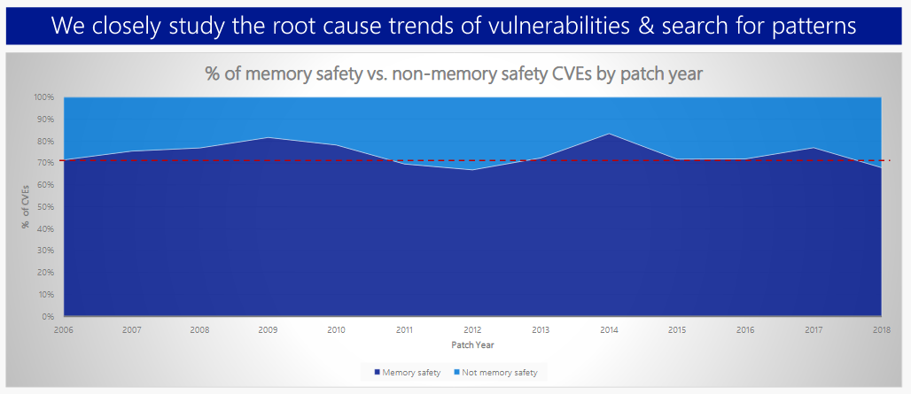
Memory corruption vulnerability is the root of all EVIL
Microsoft reported that 70% of all security bugs are due to various memory safety issues.
Control-flow hijacking attacks and use-after-free attacks are some of the most serious types of memory corruption attacks.

Slide 4
How will we overcome this problem?
Problem:
Memory corruption vulnerabilities are still a very prevalent problem, particularly control-flow hijacking and use-after-free memory attacks, with most defenses focused on x86.
However, ARM has made efforts from its side and introduced Pointer Authentication (PA), a hardware security feature to protect pointers with cryptographic primitives.
Current defenses that utilize PA either have limited coverage or high performance overhead.
Goal:
Our goal is to develop an efficient defense mechanism for ARM, utilizing PA, to protect pointers against memory corruption attacks.
Approach:
The main strength in PA is the use of a salt or modifier. We aim to provide a unique modifier that strengthens the pointer protection.
Outcome:
We developed PACTight, a PA based defense with four defense mechanisms to tightly seal sensitive pointers with high coverage and security guarantees, as well as low overhead.

Slide 5
Outline
Introduction
Background and related work
Introducing PACTight
Threat model and assumptions
PACTight design and runtime
PACTight defense mechanisms
Implementation
Evaluation
Discussion and limitations
Conclusion

Slide 6
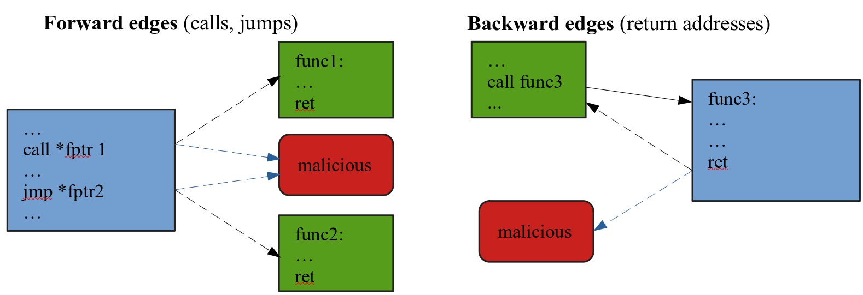
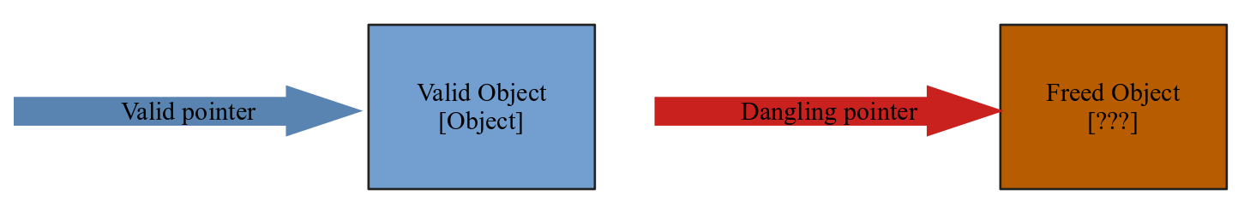
Control-flow hijacking and use-after-free attacks are critical
Control-flow hijacking attacks aim to subvert the control-flow of a program by carefully corrupting code pointers, such as return addresses and function pointers.
Use-After-Free (UAF) is a vulnerability related to incorrect use of dynamic memory during program operation.
If after freeing a memory location, a program does not clear the pointer to that memory, an attacker can use the error to hack the program.

Slide 7
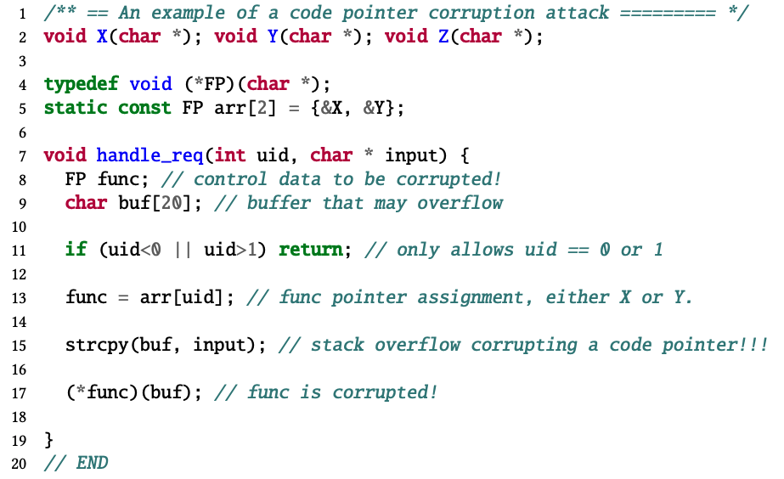
Vulnerable Control Data Example
stack
0x00
buf
Malicious ptr
func = &X
func
0xff
ret

Slide 8
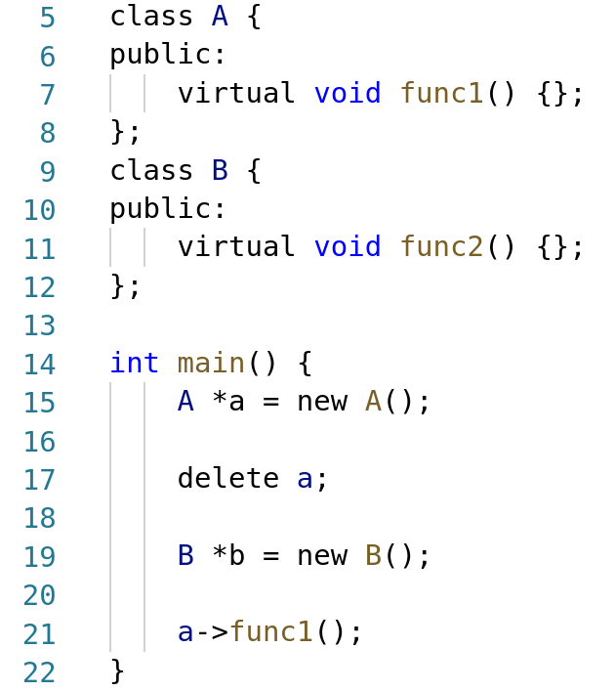
C++ VTable pointer Use-after-free example
Stack
Heap
A’s VTable
func1()
Class A
Class A
Class B
b
b
B’s VTable
a
a
func2()
ret

Slide 9
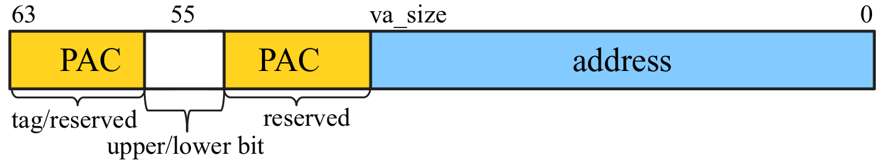
ARM’s Pointer Authentication
ARMv8.3-A introduced a new hardware security feature called Pointer Authentication (PA).
A pointer authentication code (PAC) is generated by a cryptographic hash function, as a message authentication code (MAC) to put cryptographic integrity protection on the pointers.
The PAC is then placed on the top unused bits of a 64-bit pointer.

Slide 10
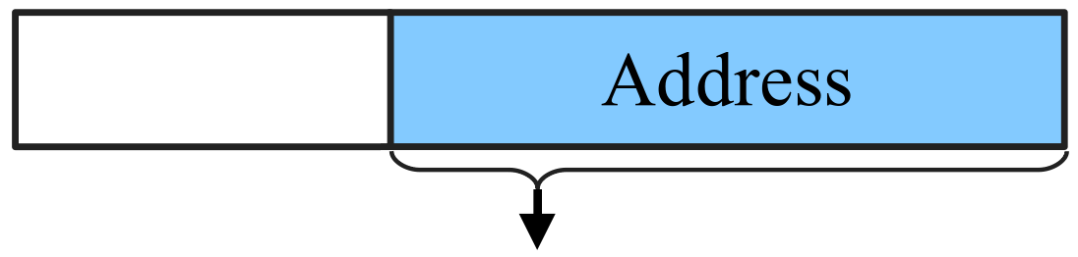

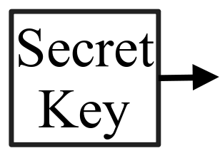
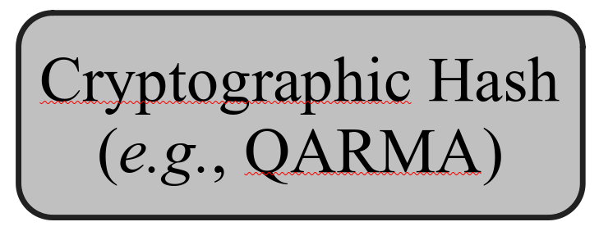
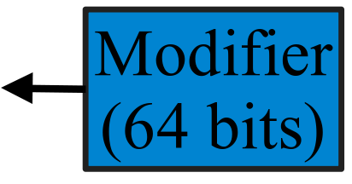
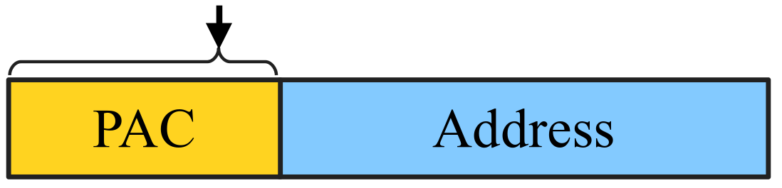
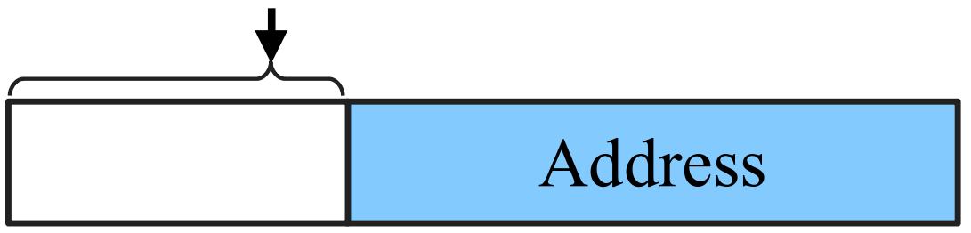
ARM’s Pointer Authentication
PAC signing
PAC utilizes a cryptographic hash algorithm, namely QARMA. The algorithm takes two 64-bit values (the pointer and modifier), as well as a 128-bit key, and generates a 64-bit PAC.
PAC authentication
Authentication of the pointer is straightforward. The cryptographic algorithm takes the pointer with the PAC and the modifier. The PAC is then regenerated and compared with the one on the passed pointer.

Slide 11
ARM’s Pointer Authentication
PAC signing
PAC utilizes a cryptographic hash algorithm, namely QARMA. The algorithm takes two 64-bit values (the pointer and modifier), as well as a 128-bit key, and generates a 64-bit PAC.
PAC authentication
Authentication of the pointer is straightforward. The cryptographic algorithm takes the pointer with the PAC and the modifier. The PAC is then regenerated and compared with the one on the passed pointer.
0x2

Slide 12
Current state-of-the-art PAC techniques
Defense | Protection scope | Attacker abilities | PAC modifier
PARTS-CFI [1] | Return addresses and indirect code pointers | Arbitrary read-write | SP (Stack Pointer) for return addresses and type-id for indirect code pointers.
PACStack [2] | Return addresses | Arbitrary read-write | Previous return address on the stack
PTAuth [3] | Heap allocated objects | Arbitrary write | A generated object-id
[1] Hans Liljestrand, Thomas Nyman, Kui Wang, Carlos Chinea Perez, Jan-Erik Ekberg, and N. Asokan. PAC it up: Towards pointer integrity using ARM pointer authentication. In Proceedings of the 28th USENIX Security Symposium (Security)
[2] Hans Liljestrand, Lachlan J. Gunn, Thomas Nyman, Jan-Erik Ekberg, and N. Asokan. Pacstack: an authenticated call stack. In Proceedings of the 30th USENIX Security Symposium (Security)
[3] Reza Mirzazade farkhani, Mansour Ahmadi, and Long Lu. Ptauth: Temporal memory safety via robust points-to authentication. In Proceedings of the 30th USENIX Security Symposium (Security)

Slide 13
Limitations of state-of-the-art PAC techniques
PARTS-CFI
Key approach: relies on a static modifier based on the LLVM ElementType.
Limitation: repeated LLVM ElementType, thus attackers can reuse the PAC generated for one in the context of using the other.
PACStack
Key approach: protecting return addresses recursively.
Limitation: relies on the presence of a forward edge CFI technique.
PTAuth
Key approach: protection against temporal attacks.
Limitations:
Defends only against attackers with arbitrary write
Vulnerable to an intra-object violation.
Pointers within the same object are copyable
Only protects the heap and doesn’t handle stack protection, even from temporal attacks

Slide 14
Outline
Introduction
Background and related work
Introducing PACTight
Threat model and assumptions
PACTight design and runtime
PACTight defense mechanisms
Implementation
Evaluation
Discussion and limitations
Conclusion

Slide 15
Introducing PACTight
Goal:
We propose PACTight, which is a PA based defense against control-flow hijacking and use-after-free attacks.
Approach and idea:
Based on the limitations of prior PA approaches, we define three security properties of a pointer such that, if achieved, prevent pointers from being tampered with. They are:
Unforgeability: A pointer should always point to its legitimate object.
Non-copyability: A pointer can only be used when it is at its specific legitimate location.
Non-dangling: A pointer cannot be used after its object has been freed.
Threat model and coverage:
PACTight assumes a stronger threat model such that the attacker has both arbitrary read and write capabilities
PACTight provides better coverage by protecting a variety of security-sensitive pointers.

Slide 16
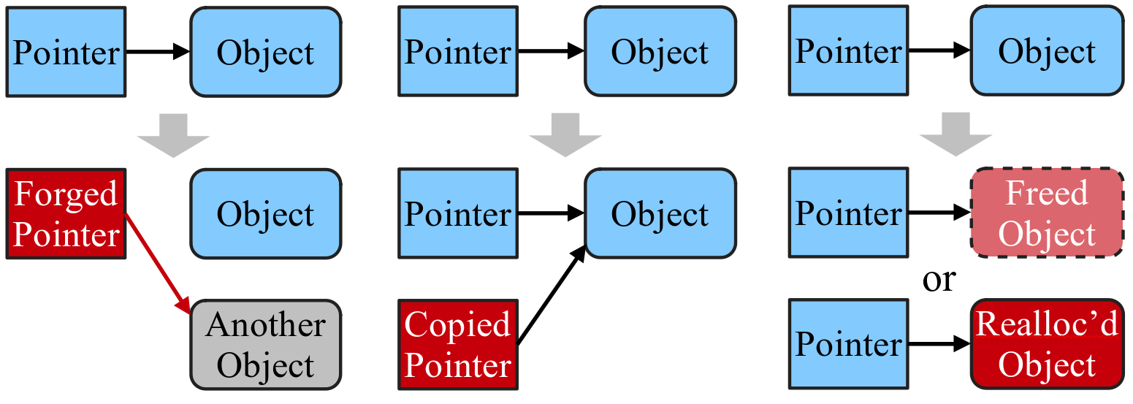
Introducing PACTight
The three properties:
Forgeability
Copyability
Dangling

Slide 17
PACTight overview
PACTight enforces the three properties in order to prevent the pointers from being abused.
PACTight tightly seals pointers and guarantees that a sealed pointer cannot be forged, copied, and is not dangling.
We implement PACTight to achieve pointer integrity by protecting all sensitive pointers and provide precise, deterministic memory safety for these sensitive pointers.
Deterministic memory safety means that we provide spatial and temporal safety for a subset of the pointers in a program, i.e. sensitive pointer.

Slide 18
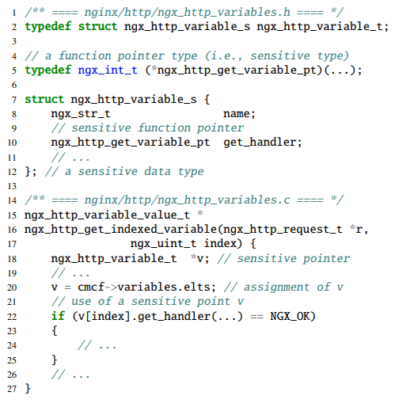
PACTight: Sensitive pointer definition
Sensitive pointers here refers to all code pointers and data pointers that can reach to a code pointer.
Protecting these sensitive pointers achieves the balance between full memory safety and protecting only function pointers.
Example of a sensitive data pointer in (simplified) NGINX source code. ngx_http_variable_t is a sensitive data type since it contains a function pointer get_handler (Line 10).

Slide 19
Outline
Introduction
Background and related work
Introducing PACTight
Threat model and assumptions
PACTight design and runtime
PACTight defense mechanisms
Implementation
Evaluation
Discussion and limitations
Conclusion

Slide 20
Threat model and assumptions
Our threat model assumes a powerful adversary with read and write capabilities by exploiting input-controlled memory corruption errors in the program.
The attacker cannot inject or modify code due to Data Execution Prevention (DEP), which is by default enabled in most modern operating systems
We assume that the hardware and kernel are trusted, specifically that the PA secret keys are generated, managed and stored securely.
Attacks targeting the kernel and hardware attacks, such as Spectre, are out of scope.

Slide 21
Outline
Introduction
Background and related work
Introducing PACTight
Threat model and assumptions
PACTight design and runtime
PACTight defense mechanisms
Implementation
Evaluation
Discussion and limitations
Conclusion

Slide 22
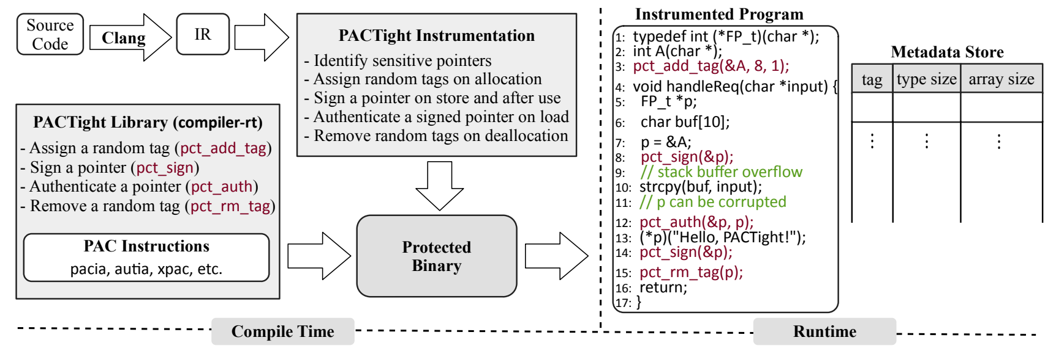
PACTight overall design

Slide 23
PACTight design and runtime: Enforcing the properties
In order to enforce the three properties, PACTight relies on the PAC modifier.
The modifier is a user-defined salt that is incorporated by the cryptographic hash into the PAC in addition to the address.
Any changes in either the modifier or the address result in a different PAC, detecting the violation.

Slide 24
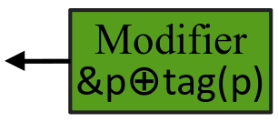
PACTight design and runtime: Enforcing the properties
We propose to blend the address of a pointer (&p) and a random tag (tag(p)) associated with a memory object to efficiently enforce the PACTight pointer integrity property

Slide 25
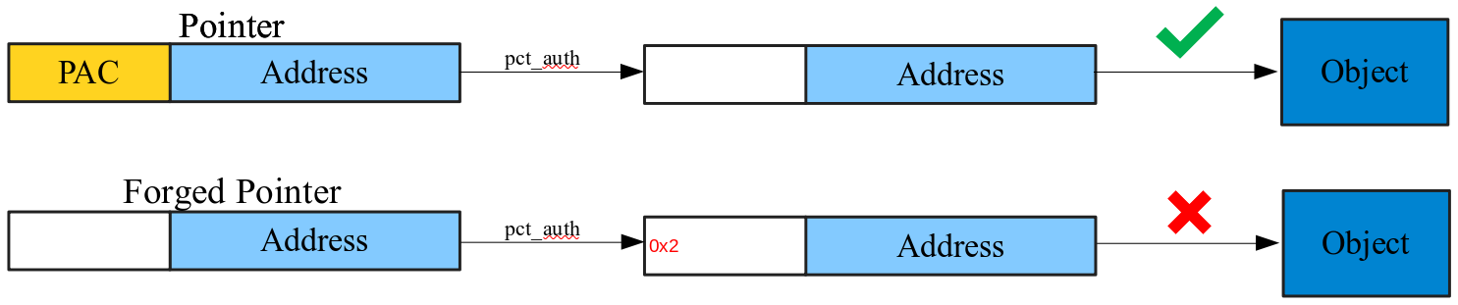
PACTight design and runtime: Enforcing the properties
Unforgeability: The PAC mechanism includes the pointer as one of the inputs to generate the PAC. If the pointer is forged, it will be detected at authentication.

Slide 26
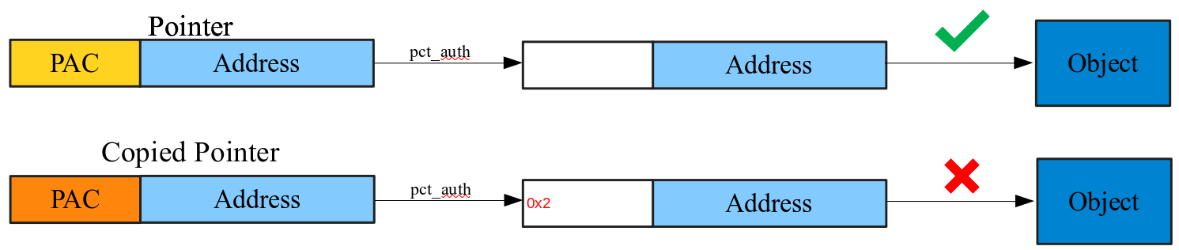
PACTight design and runtime: Enforcing the properties
Non-copyability: PACTight adds the location of the pointer (&p) as a part of the modifier. This guarantees that the pointer can only be used at that specific location. Any change in the location by copying the pointer changes the modifier and thus triggers an authentication fault.

Slide 27
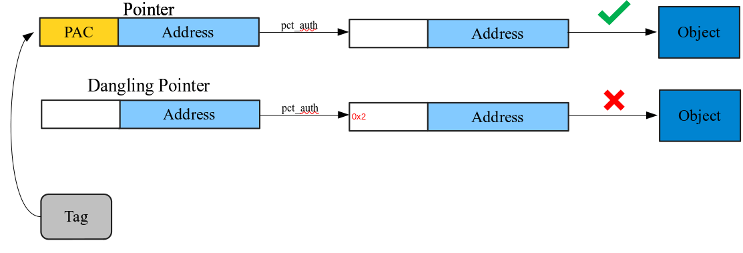
PACTight design and runtime: Enforcing the properties
Non-dangling: PACTight uses a random tag ID to track the life cycle of a memory object.The life cycle of a PACTight-sealed pointer is bonded to that of a memory object.

Slide 28
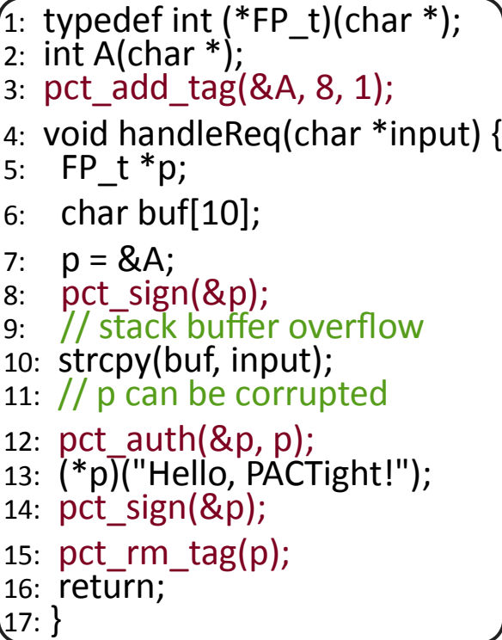
PACTight Runtime: Runtime library
The PACTight runtime library provides four APIs to enforce pointer integrity.
pct_add_tag(p,tsz,asz) sets the metadata for a newly allocated memory region.
pct_sign(&p) signs a pointer with the associated random tag that was generated by pct_add_tag.
pct_auth(&p, p+N) authenticates a pointer with the associated metadata.
pct_rm_tag(p) removes the metadata associated to a pointer from the metadata store.

Slide 29
PACTight Runtime: Pointer operations
Since a PACTight-signed pointer has a PAC in its upper bits, care must be taken not to break the semantics of existing C/C++ pointer semantics. In particular, we take care of the following cases:
PACTight-signed pointer comparison:
Even if two pointers refer to the same memory address, their PACs are different since the locations of the two pointers are different (i.e., &p!=&q). Hence, PACTIGHT strips off the PAC from the PACTIGHT-signed pointer before comparison by looking for the icmp instruction.
PACTight-signed pointer assignment:
When assigning one signed pointer (source) to another signed pointer (target), the target pointer should be signed again with its location
PACTight-signed pointer argument:
There are functions that directly manipulate a pointer. For those functions, PACTIGHT strips off the PAC before passing the signed pointer as an argument.

Slide 30
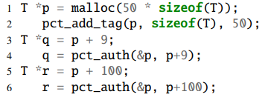
PACTight Runtime: Pointer operations
Since a PACTight-signed pointer has a PAC in its upper bits, care must be taken not to break the semantics of existing C/C++ pointer semantics. In particular, we take care of the following cases:
PACTight-signed pointer arithmetic: PACTight supports pointer arithmetic on arrays. In the case of arrays, all elements in the array get the same unique random tag, with the rest of the metadata keeping track of the size of an element and the number of elements in the array. This is done to efficiently enforce spatial safety.
The mechanism works the same for temporal memory safety; a freed object will not have a tag, and newly allocated object in the same location will have a different random tag. Thereby, PACTight can effectively reject spatial memory violation and temporal memory violation.

Slide 31
PACTight Runtime: Metadata Store
PACTight maintains a metadata store for allocated memory objects. For each allocated memory object, the metadata store maintains a 64-bit random tag ID, the size of each individual element (or type size), and the number of elements in an array (or array size).
Non-array objects will be treated as an array having a single element.
We implemented the metadata store as a hash table using the address (i.e., p) as a key.
The metadata store is allocated when the program starts and is maintained by PACTight’s runtime library.

Slide 32
PACTight overall design

Slide 33
Outline
Introduction
Background and related work
Introducing PACTight
Threat model and assumptions
PACTight design and runtime
PACTight defense mechanisms
Implementation
Evaluation
Discussion and limitations
Conclusion

Slide 34
PACTight Defense Mechanisms
Now we present the PACTight defense mechanisms built on top of the PACTight design and runtime.
The PACTight compiler passes automatically instrument all globals, stack variables and heap variables in a program, inserting the necessary PACTight APIs.
We implement four defense mechanisms:
Control-Flow Integrity (forward edge protection)
C++ VTable pointers protection
Code Pointer Integrity (all sensitive pointer protection)
Return address protection (backward edge protection).

Slide 35
PACTight Defense Mechanisms: PACTight-CFI
PACTight-CFI guarantees forward-edge control-flow integrity by ensuring the PACTight pointer integrity properties for all code pointers.
It authenticates the PAC on a function pointer at legitimate function call sites. At all other sites, the code pointer is sealed with the PACTight signing mechanism so it cannot be abused.
PACTight-CFI identifies all code pointers using LLVM type information. PACTight-CFI also recursively looks through all elements inside a composite type.
PACTight-CFI enforces the PACTight pointer integrity properties on code pointers and this implies that the equivalence class (EC) size (i.e., the number of allowed legitimate targets at one call site) is always one

Slide 36
PACTight Defense Mechanisms: PACTight-VTable
C++ relies on virtual functions to achieve dynamic polymorphism. At every virtual function call, a proper function is used in accordance with the object type.
The mapping of an object type to a virtual function is done by the use of a virtual function table (VTable) pointer, which is a pointer to an array of virtual function pointers per object type.
PACTight-VTable identifies a VTable pointer in a C++ object by analyzing types in LLVM. It investigates all composite types and checks if it is a class type having one or more virtual functions.

Slide 37
PACTight Defense Mechanisms: PACTight-CPI
PACTight-CPI increases the coverage of PACTight-CFI to guarantee integrity of all sensitive pointers.
Sensitive pointers are all code pointers (i.e., PACTight-CFI coverage) and all data pointers that point to code pointers.
PACTight-CPI expands the type analysis of PACTight-CFI to include sensitive data pointers as well as code pointers, in addition to return addresses and C++ VTable pointers.

Slide 38
PACTight Defense Mechanisms: PACTight-RET
Protecting return addresses is critical because they are, after all, the root of ROP attacks. At the same time, the return address protection scheme should impose minimal performance overhead.
One interesting fact is that a return address can not be a dangling pointer. Hence the non-dangling property is not necessary to be enforced so the random tag is also not necessary.
Not using the random tag has huge performance benefits because the metadata store lookup to get the random tag can be removed.

Slide 39
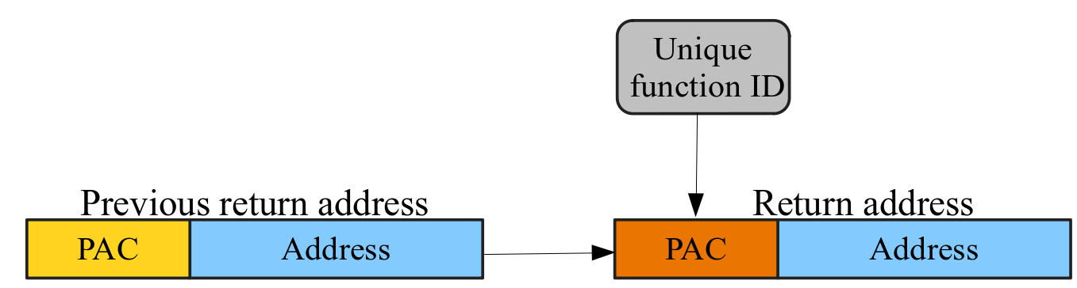
PACTight Defense Mechanisms: PACTight-RET
Instead of blending the location of a return address in a stack to provide the non-copyability property, we use the signed return address of a previous stack frame.
We blend a caller’s unique function ID and the signed return address from the previous stack frame to generate the modifier.

Slide 40
Outline
Introduction
Background and related work
Introducing PACTight
Threat model and assumptions
PACTight design and runtime
PACTight defense mechanisms
Implementation
Evaluation
Discussion and limitations
Conclusion

Slide 41





PACTight Implementation
LLVM Compiler pass
AArch64 Backend
Custom compiler pass for static analysis and instrumentation
(3237 LoC)
In order to efficiently enforce PACTight-RET
(121 LoC)
PACTight API library
Library for PACTight primitives
(656 LoC)
+Additional support
Link Time Optimization (LTO)

Slide 42
Outline
Introduction
Background and related work
Introducing PACTight
Threat model and assumptions
PACTight design and runtime
PACTight defense mechanisms
Implementation
Evaluation
Discussion and limitations
Conclusion

Slide 43
Evaluation: Evaluation methodology
We evaluate PACTight by answering the following questions:
How effectively can PACTIGHT prevent not only synthetic attacks but also real-world attacks by enforcing PACTIGHT pointer integrity properties?
How much performance and memory overhead does PACTIGHT impose?
Evaluation environment:
We ran all evaluations on Apple’s M1 processor, which is the only commercially available processor supporting ARMv8.4 architecture with ARM PA instructions.
Specifically, we used an Apple Mac Mini M1 equipped with 8GB DRAM, 4 big cores, and 4 small cores.
We ported our PACTight prototype to Apple’s LLVM 10 fork. For all applications, we enabled O2 and LTO optimizations for fair comparison.

Slide 44
Evaluation: Security Evaluation
We evaluated PACTIGHT with three real-world exploits to test its effectiveness against real vulnerabilities
CVE 2015-8668: This is a heap-based buffer overflow in the image file format library libtiff. PACTight-CFI/CPI successfully detects this and stops it from completing by enforcing pct_auth on the corrupted function pointer.
CVE-2019-7317: This is a use-after-free exploit in libpng library, which implements an interface for reading and writing PNG format files. Since PACTight-CPI does recursive identification, image is considered sensitive by PACTight-CPI.
CVE-2014-1912: This is a buffer overflow vulnerability in python2.7 that happens due to a missing buffer size check. PACTight-CFI/CPI detects this by detecting the corrupted function pointer with pct_auth.

Slide 45
Evaluation: Security Evaluation
We evaluated PACTight with five synthesized attacks for C++ to demonstrate how PACTight-VTable can defend against virtual function pointer hijacking attacks, COOP attacks - a Turing complete attack that crafts fake C++ objects.
We used CFIXX [1] C++ test suite by Burow et al. It contains four virtual function pointer hijacking exploits (FakeVT-sig, VTxchg-hier, FakeVT, VTxchg) and one COOP exploit.
PACTight-VTable detects all the exploits by enforcing pct_auth on the virtual function pointer before the virtual function call to detect if it has been corrupted.
[1] Nathan Burow, Derrick McKee, Scott A. Carr, and Mathias Payer. CFIXX: Object Type Integrity for C++ Virtual Dispatch. In Proceedings of the 2018 Annual Network and Distributed System Security Symposium (NDSS), San Diego, CA, February 2018

Slide 46
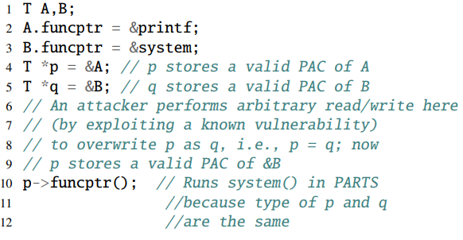
Evaluation: Security Evaluation
We describe here a synthesized exploit that bypasses PARTS and PTAuth, relying on the security guarantees provided by the non-copyability property.
PARTS [1] is vulnerable to this attack while PACTight is not. This is possible in PARTS since both pointers have the same LLVM ElementType. Our incorporation of a pointer location (&p) into the modifier with the non-copyability property blocks this attack.
[1] Hans Liljestrand, Thomas Nyman, Kui Wang, Carlos Chinea Perez, Jan-Erik Ekberg, and N. Asokan. PAC it up: Towards pointer integrity using ARM pointer authentication. In Proceedings of the 28th USENIX Security Symposium (Security)

Slide 47
Evaluation: Performance Evaluation
For performance evaluation, we use three benchmarks – namely SPEC CPU2006, nbench, and CoreMark – which have been used in prior works, and one real-world application, NGINX web server.
In order to run SPEC CPU2006, we ported the SPEC benchmark to the Apple M1 and built it from scratch.
We were not able to run one benchmark, 403.gcc, in the SPEC benchmark on the Apple M1 even with Apple’s vanilla Clang/LLVM compiler so we omitted the results of 403.gcc. We suspect that there is a bug in the MacOS/M1 toolchain.

Slide 48
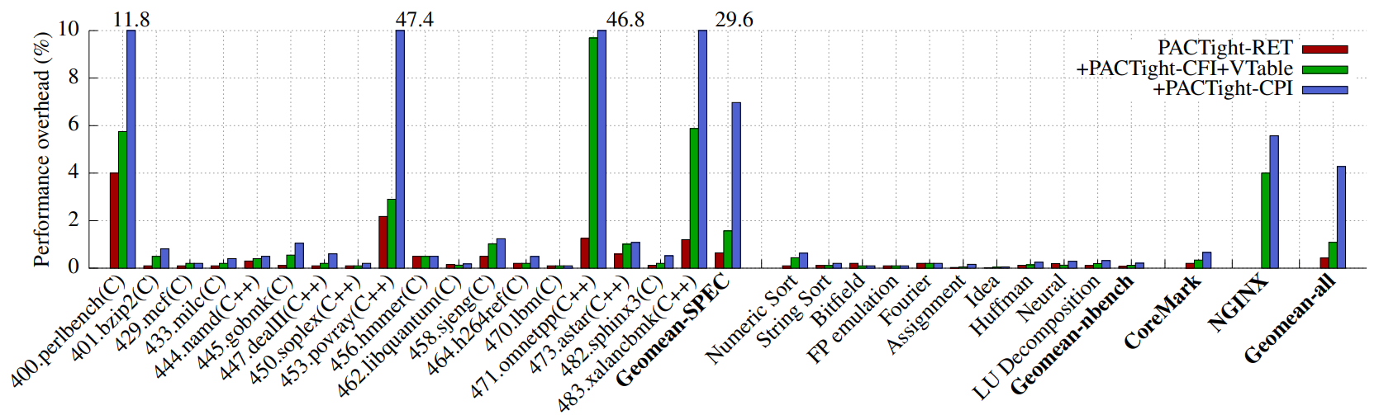
Evaluation: Performance Evaluation
The SPEC benchmarks have a geometric mean of 0.64%, 1.57%, and 6.97% for PACTIGHT-RET, PACTIGHTCFI+VTable+RET, and PACTIGHT-CPI, respectively. The geometric means of all benchmark applications are 0.43%, 1.09%, and 4.28% for PACTIGHT-RET, PACTIGHT-CFI+VTable+RET, and PACTIGHT-CPI, respectively.
As can be seen, PACTIGHT has very low overhead on almost all benchmarks and across all the protection mechanisms.

Slide 49
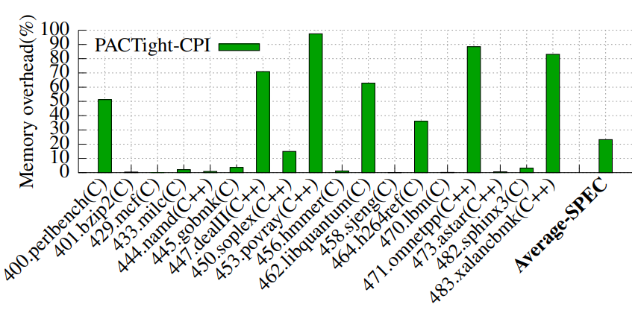
Evaluation: Performance Evaluation
In order to see how much additional memory is used for PACTIGHT metadata store, we measured the maximum resident set size (RSS) during the execution of the SPEC CPU2006 benchmarks.
We ran the SPEC benchmarks with the PACTIGHT-CPI protection because it is the highest level of protection in PACTIGHT so it requires the largest number of entries in the metadata store.
In spite of measuring the highest security mechanism with the most instrumentations, PACTIGHT imposes an overhead of 23% on average.

Slide 50
Outline
Introduction
Background and related work
Introducing PACTight
Threat model and assumptions
PACTight design and runtime
PACTight defense mechanisms
Implementation
Evaluation
Discussion and limitations
Conclusion

Slide 51
Discussion and limitations
Information leakage attack on the metadata store:
In our threat model, assuming a powerful attacker with arbitrary read and write capabilities, an attacker is able to access the PACTight metadata store while it is probabilistically hidden using address space layout randomization (ASLR).
However, even if the PACTight metadata is leaked, an attacker is not able to exploit the leaked information.
In order for an attacker to take advantage of the leakage, she has to launch an attack from a different location and this is already protected by the non-copyability property.

Slide 52
Discussion and limitations
PACTight-CPI over-approximation
We over-approximate when detecting security-sensitive pointers in our static analysis. That is, we regard a pointer as a security-sensitive pointer if we cannot determine a pointer as non-security-sensitive at static time.
This conservative approach may induce false positives, however, such false positives will not compromise PACTight’s security guarantees
Alternative Return Address Protection.
We believe that extending PACTight’s return address mechanism to use ARM Memory Tagging Extention (MTE) or an approach similar to Intel CET – hardware-based secure shadow stack – would result in a more secure mechanism than the current one.

Slide 53
Outline
Introduction
Background and related work
Introducing PACTight
Threat model and assumptions
PACTight design and runtime
PACTight defense mechanisms
Implementation
Evaluation
Discussion and limitations
Conclusion

Slide 54
Conclusion
PACTight is an efficient and robust mechanism to guarantee pointer integrity utilizing ARM’s Pointer Authentication mechanism.
We identified three security properties that PACTight enforces to ensure pointer integrity
We implemented PACTight with four defense mechanisms, protecting forward edge, backward edge, virtual function pointers, and sensitive pointers.
We demonstrated the security of PACTight against real-world and synthesized attacks and showcased its low performance and memory overhead, 4.28% and 23.2% respectively, against a variety of benchmarks, including SPEC 2006, nbench and CoreMark with real PAC instructions.

Slide 55
Publications so far
Tightly Seal Your Sensitive Pointers with PACTight
Mohannad Ismail, Andrew Quach, Christopher Jelesnianski, Yeongjin Jang, Changwoo Min
Under submission at the 31st USENIX Security Symposium [Major Revision]
VIP: Safeguard Value Invariant Property for Thwarting Critical Memory Corruption Attacks
Mohannad Ismail+, Jinwoo Yom+, Christopher Jelesnianski, Yeongjin Jang, and Changwoo Min
In Proceedings of Conference on Computer and Communications Security (CCS 2021)
Witcher: Systematic Crash Consistency Testing for Non-Volatile Memory Key-Value Stores
Xinwei Fu, Wook-Hee Kim, Ajay Paddayuru Shreepathi, Mohannad Ismail, Sunny Wadkar, Dongyoon Lee, and Changwoo Min
In Proceedings of ACM Symposium on Operating Systems Principles (SOSP 2021)
POSEIDON: Safe, Fast and Scalable Persistent Memory Allocator
Anthony Demeri, Wook-Hee Kim, R. Madhava Krishnan, Jaeho Kim, Mohannad Ismail, and Changwoo Min
In Proceedings of the 12th Annual Non-Volatile Memories Workshop (NVMW 2021)
POSEIDON: Safe, Fast and Scalable Persistent Memory Allocator
Anthony Demeri, Wook-Hee Kim, R. Madhava Krishnan, Jaeho Kim, Mohannad Ismail, and Changwoo Min
In Proceedings of the 21st ACM/IFIP International Middleware Conference (Middleware 2020)

Slide 56
Summer internship experience
Intern, Member Of Technical Staff
VMware
Member of the ESXi-ARM team
Implemented and added support for ARM’s hardware security feature Pointer Authentication in ESXi-ARM. Support includes detecting hardware support, initializing the keys with a pseudorandom generator, and configuring the registers. Support was added in the vmkernel.
Contributed a fix for ESXi-ARM on QEMU to QEMU open source.
Participated in various tasks with the team and contributed to the ESXi source code.
Dates Employed: May 2021 – Aug 2021
I will be rejoining VMWare again (return offer) this next summer (2022), where I will be working with the same team again in Palo Alto, CA.

Slide 57
Thank You !
Questions?

Slide 58
Extra slides

Slide 59
PACTight Design: Achieving our goal
Goal:
The overarching goal of PACTight is completely preventing control-flow hijacking and use-after-free attacks in a program with low performance overhead and be compatible with legacy (C/C++) programs.
Properties:
In order to achieve this goal, we decided to enforce protection of the three properties on sensitive pointers
Sensitive pointers are all code pointers and all data pointers that are reachable to any code pointer
Guaranteeing the integrity of all sensitive pointers is sufficient to make control-flow hijacking impossible.
Approach:
Our approach relies on leveraging Pointer Authentication to enforce the three properties.
PACTight relies on a unique modifier to enforce all three properties.
Instrumentation is done by static analysis of the LLVM IR.
Pointers are signed and authenticated with the PACTight runtime library

Slide 60
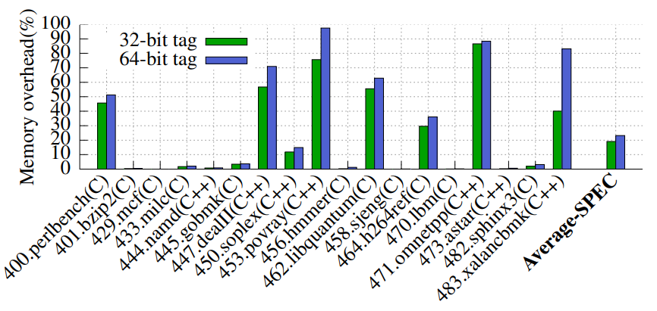
Evaluation: Performance Evaluation - 32-bit tag
PACTIGHT imposes an overhead of 23% on average for 64-bit tags and 19% on average for 32-bit tags.
This makes sense due to the metadata being 16 bytes in the case of a 64-bit tag, and 12 bytes in the case of a 32-bit tag.
The difference in memory overhead between 32-bits and 64-bit tags is around 4%, but use of 64-bit tags provides a much
higher level of entropy.

Slide 61
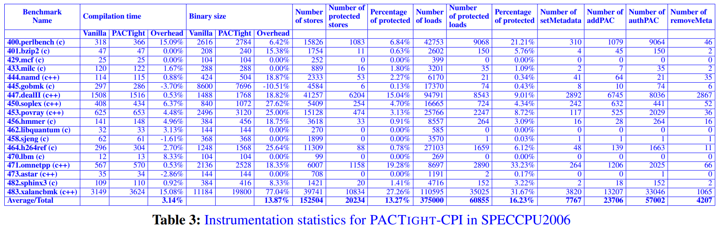
Instrumentation statistics

Slide 62
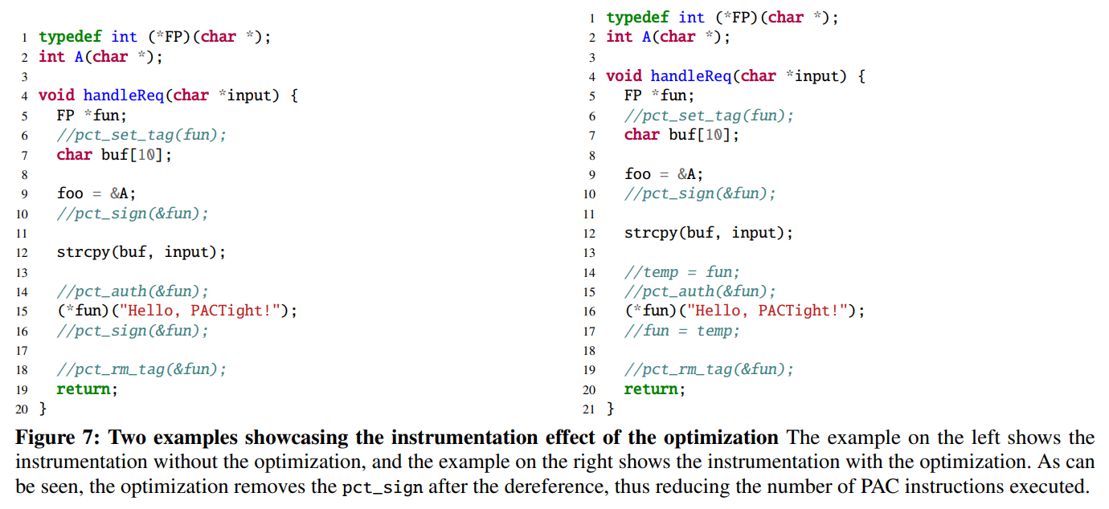
PACTight optimization

Slide 63
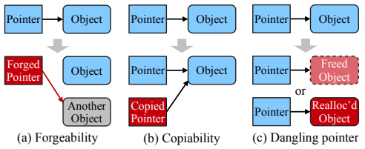
PACTight Design: Pointer integrity
Based on the limitations of prior PAC approaches and our observation on how a pointer can be compromised, we define three security properties of pointer integrity.
Unforgeability: A pointer can be forged (i.e., corrupted) to point to an unintended memory object.
Non-copyability: A pointer can be copied and re-used maliciously. If non-copyability is guaranteed, the security impact is non-replayability, and thus pointer attacks that replay PAC-ed pointers for malicious use would be prevented.
Non-dangling: A pointer can refer an unintended memory object if its pointee object is freed or the freed memory is reallocated

